Slide 1
Milestone 2
Hoyoung Kim

Slide 2
AWS
Amazon Web service is a site that major corporate rely on that when breached, could cause catastrophe to the business and its customers
Major business include: Airbnb, Netflix, McDonalds, Twitch, Pfizer, Twitter

Slide 3
AWS Security
AWS uses MFA, Access keys and IAM for reliable security
Majority pitfalls lie in IAM where permission boundaries are set
And with recent growth of AWS, AWS security team and the Cyber security community has been over and under the system.
Some of the key players are Steven Schmidt and Troy Hunt

Slide 4
Security Perspective
Compliance: Aligning IAM with regulatory standards like GDPR(General Data Protection Regulation), HIPAA, PCI DSS(Payment Card Industry Data Security Standard).
Business: Balancing security needs with operational efficiency.

Slide 5
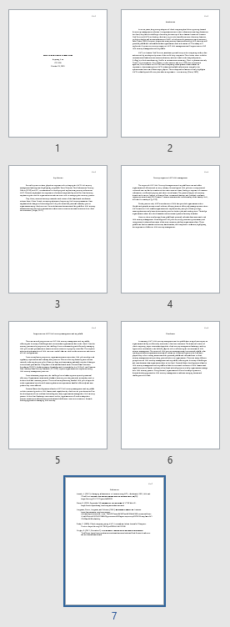
references
Anand, A. (2017). Managing infrastructure in Amazon using EC2, cloudwatch, EBS, IAM and CloudFront. International Journal of Engineering Research And, V6(03). https://doi.org/10.17577/ijertv6is030335
Davis, B. (2022, September 26). Companies that use AWS. MYTECHMAG. https://www.mytechmag.com/companies-that-use-aws/
Longman, Green, Longman, and Roberts. (1861). Government education. Amazon. https://aws.amazon.com/government-education/government/#:~:text=The%20Trusted%20Cloud%20for%20Government&text=With%20over%207%2C500%20government%20agencies,security%2C%20compliance%2C%20and%20reliability.
Sinha, P. (2020). Cloud computing using AWS: An analysis. Indian Journal of Computer Science. https://doi.org/10.17010/ijcs/2020/v5/i6/157500
Wright, R. (2017, December 7). Risk & repeat: Analyzing the accidental data breach. TechTarget. https://www.techtarget.com/searchsecurity/podcast/Risk-Repeat-Analyzing-the-accidental-data-breach

